Slide 1

Which Game Engine Should You Use?
Sean O’Connor

Slide 2
What is a Game Engine?
Game Engines are tools that support and expedite the process of creating video games. They achieve this by creating native solutions for implementing physics, rendering pipelines, game cycle updates, animations, and interactions between game objects.

Slide 3




Public Game Engines

Slide 4
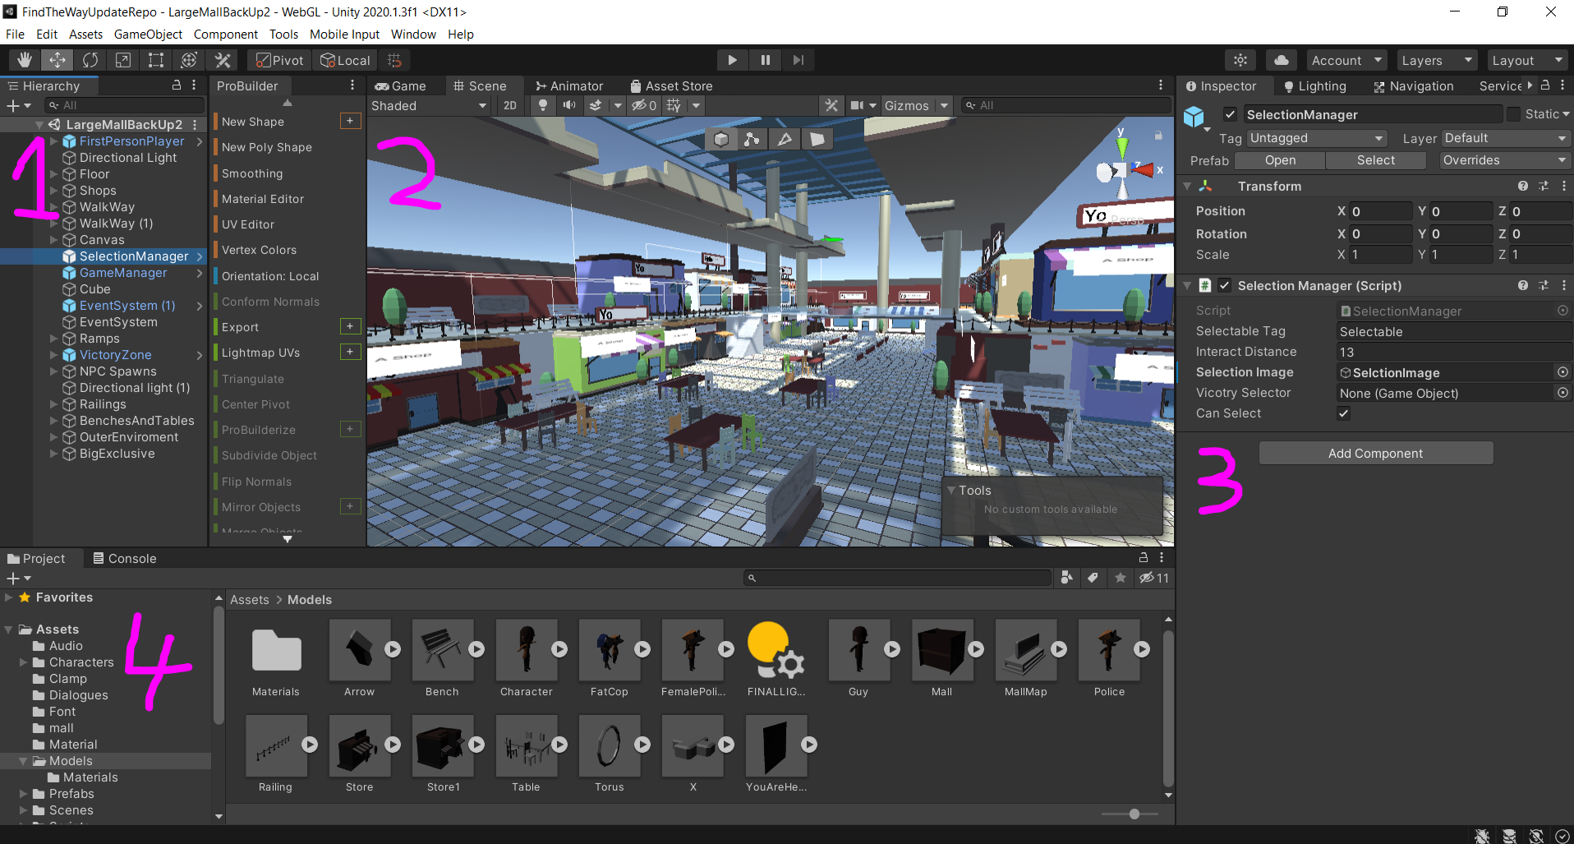
Editor Break Down
1: Hierarchy
2: Scene View
3: Inspector
4: Project Files

Slide 5
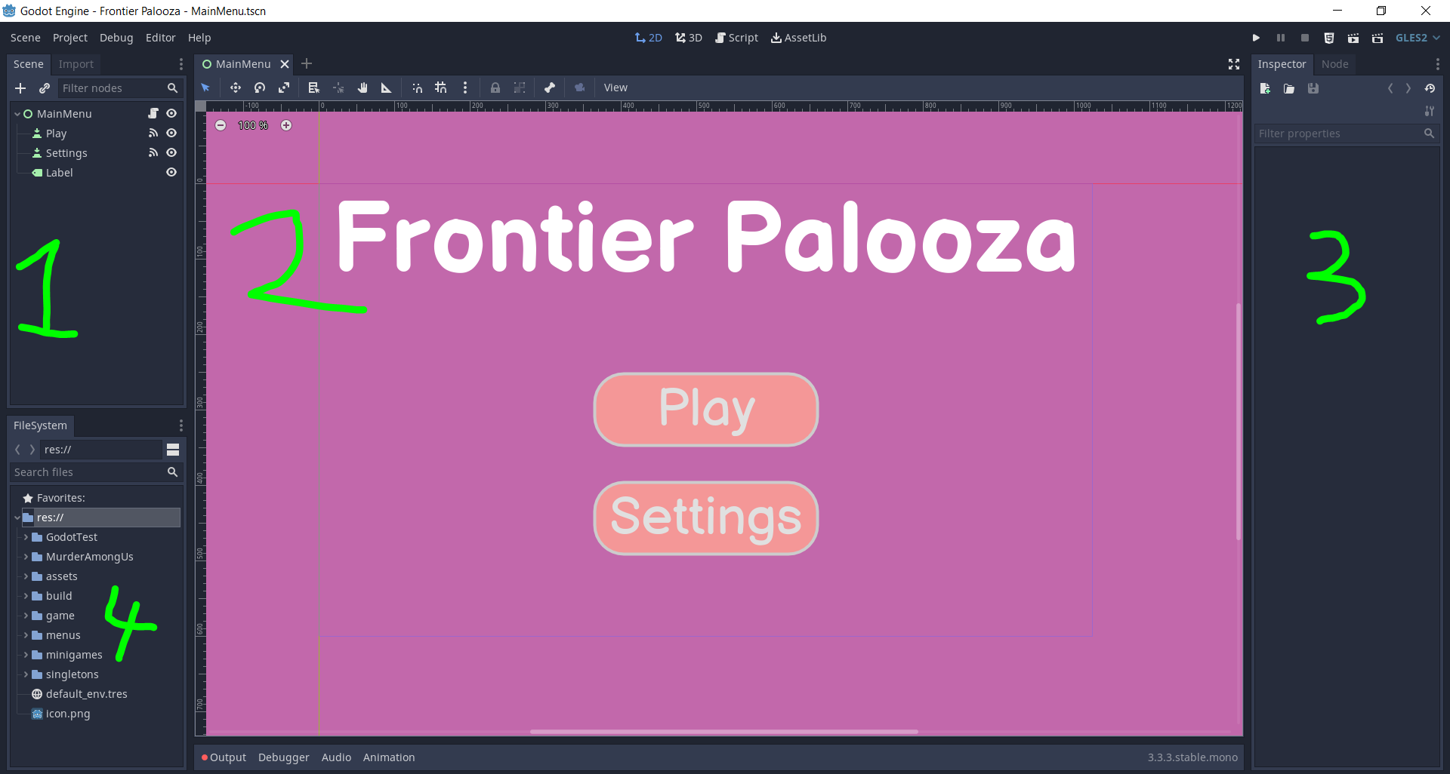
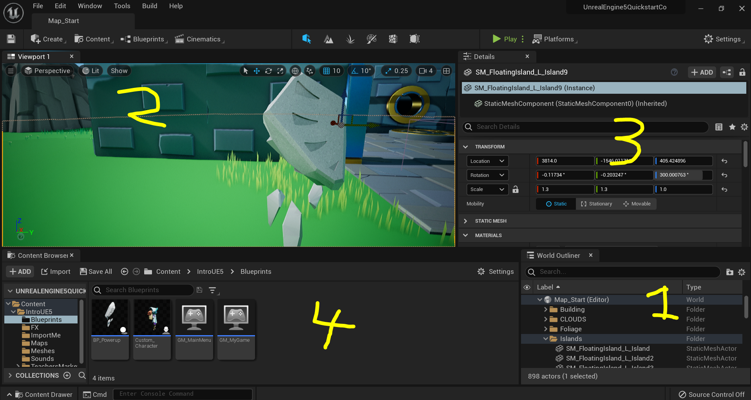
Godot
Unreal

Slide 6
Revenue Cuts
Unity will require a Pro license on when you make above $100,000
Unreal takes a 5% cut from revenue on applications once they make $3,000 per quarter

Slide 7

That is not going to happen!
And if it does happen…you don’t have to worry about anything!

Slide 8
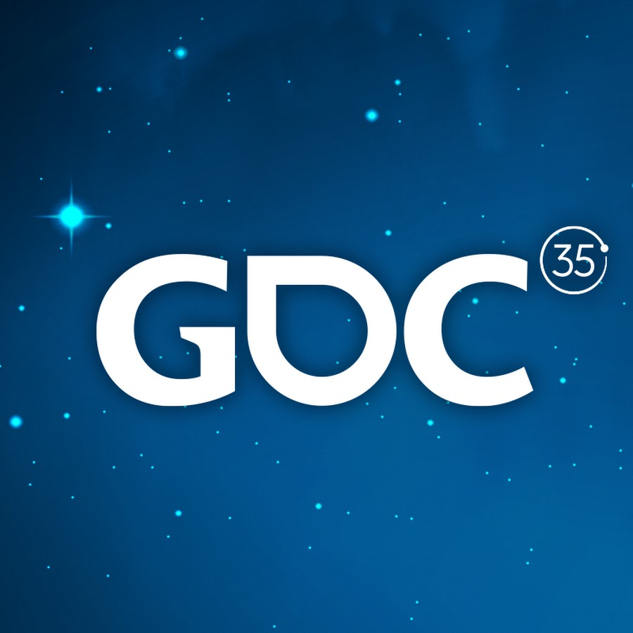


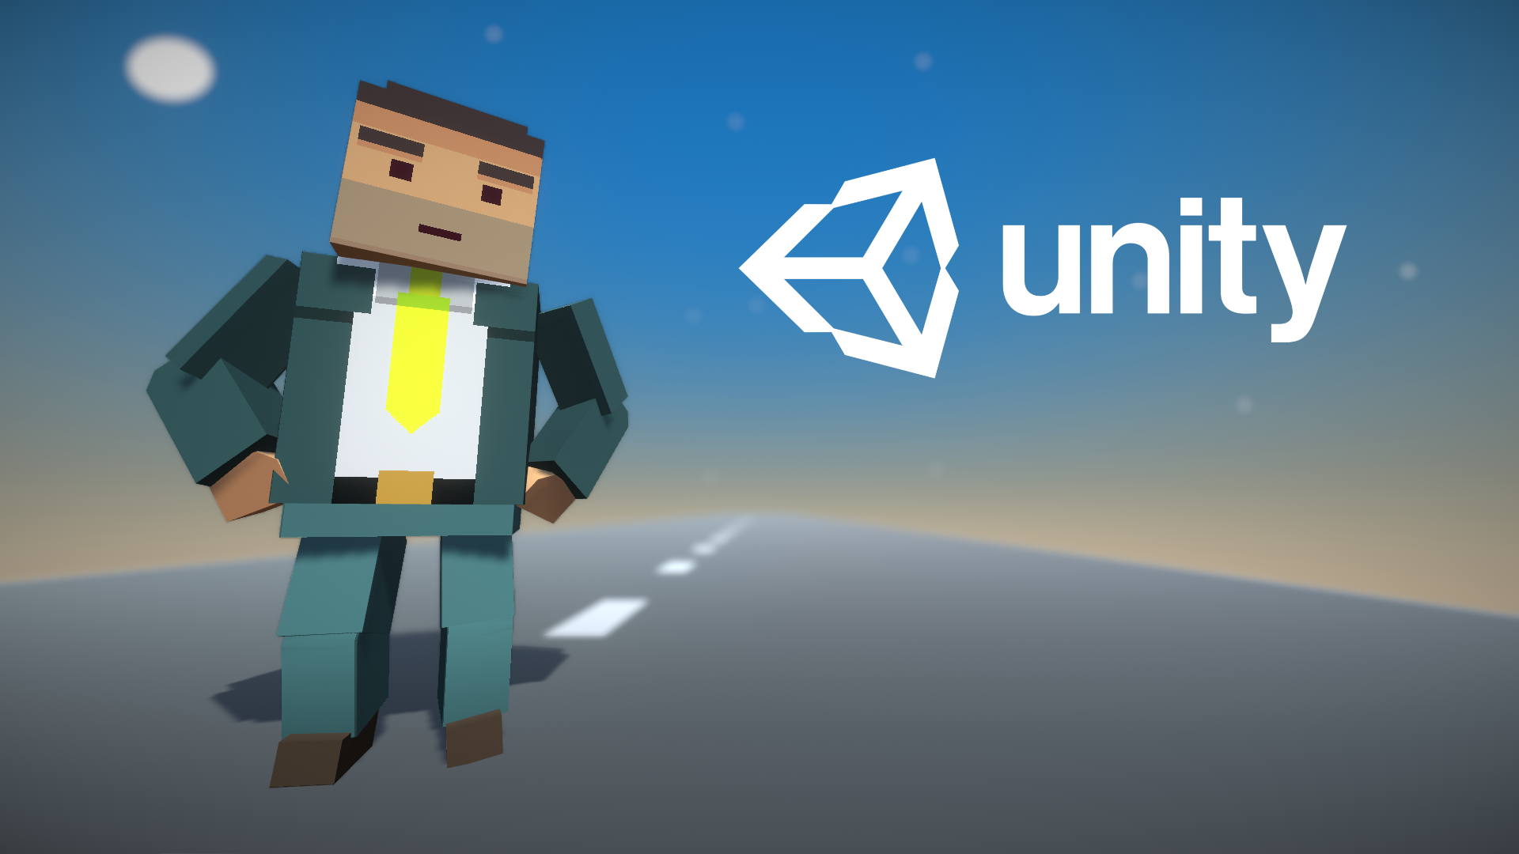

Good Resources
Unity Learn (Create With Code)
GDC Talks
YouTube
Create With Code

